Slide 1
Andrew S Tanenbaum 4th Edition
Computer Networks

Slide 2
Syllabus
Module I
Introduction – Uses – Network Hardware – LAN – MAN – WAN, Internetworks – Network Software – Protocol hierarchies – Design issues for the layers – Interface & Service – Service Primitives. Reference models – OSI – TCP/IP.
Data Link layer Design Issues – Flow Control and ARQ techniques. Data link Protocols – HDLC. DLL in Internet.

Slide 3
Introduction
Computer Network:
Interconnected collection of autonomous computers
2 computers are interconnected if they are able to exchange information
Communication is the process of exchanging information between two persons or devices
Connection can be made via copper wire, fiber optics, microwaves or communication satellites etc
If one computer cannot forcibly start, stop or control another computer then it is termed as autonomous

Slide 4
Uses of Computer Networks
Business Applications or
Networks for companies
Home applications or
Networks for People
Mobile Network Users
Social Issues

Slide 5
Uses of Computer Networks
Business Applications
Resource Sharing
programs, equipment, data etc
High reliability
alternative sources of supply
Saving money
by having client server model
Scalability
Ability to increase system performance
Powerful Communication medium
online documents, human to human communication

Slide 6
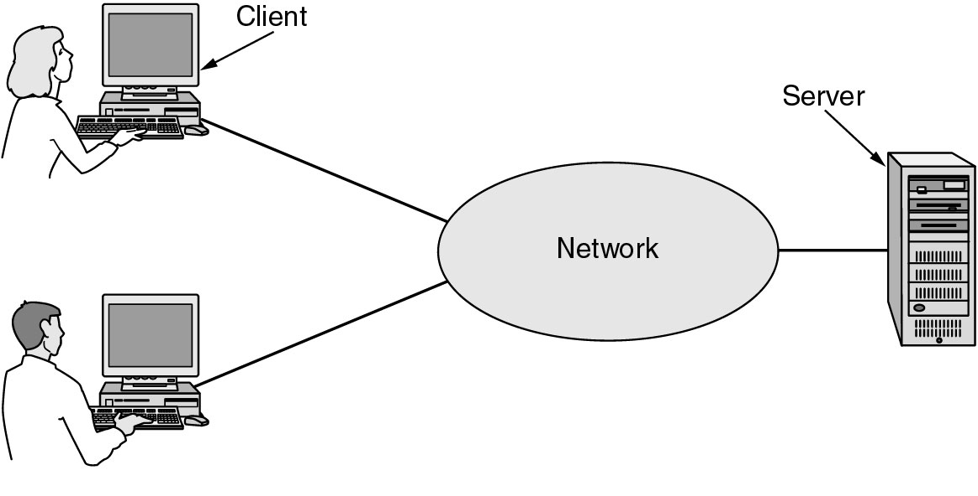
Business Applications of Networks
A network with two clients and one server.

Slide 7
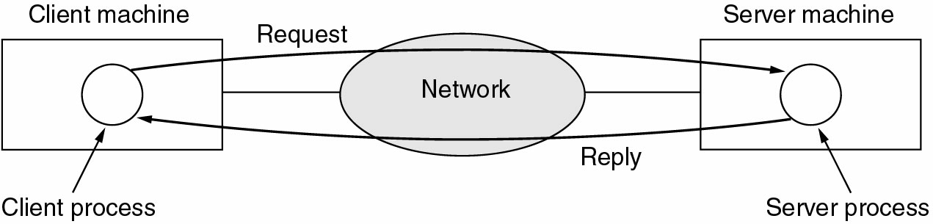
Business Applications of Networks
The client-server model involves requests and replies.

Slide 8
Home Network Applications
Access to remote information
Home shopping
Online newspaper
Access to WWW
Person-to-person communication
E-mails
Video conference
Worldwide newsgroup

Slide 9
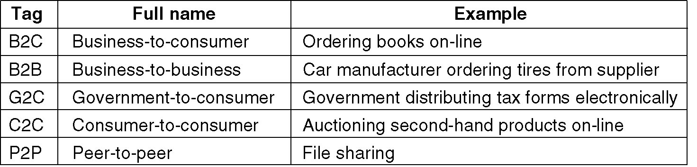
Home Network Applications
Interactive entertainment
Video on demand
Live Television
Game playing
Electronic commerce (e-commerce)
convenience of shopping from home with online catalogs

Slide 10
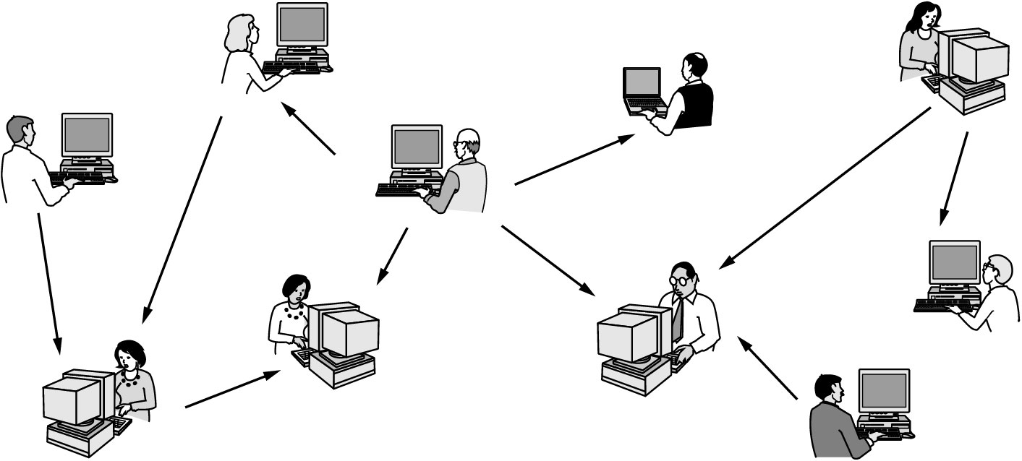
Home Network Applications
In peer-to-peer system there are no fixed clients and servers.

Slide 11
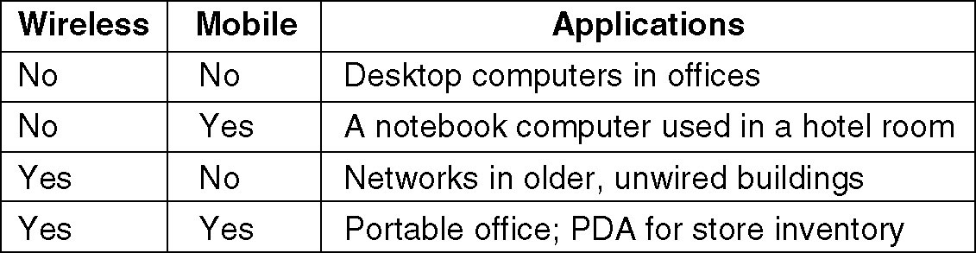
Mobile Network Users
Mobile commerce (m-commerce)
Social Issues
Exchange messages using newsgroup may lead to conflicts
Employee rights vs employer rights
Network offers the potential to send anonymous messages
Electronic junk mails (Spam) may contain viruses
Copyright violation due to transmission of music & videos

Slide 12
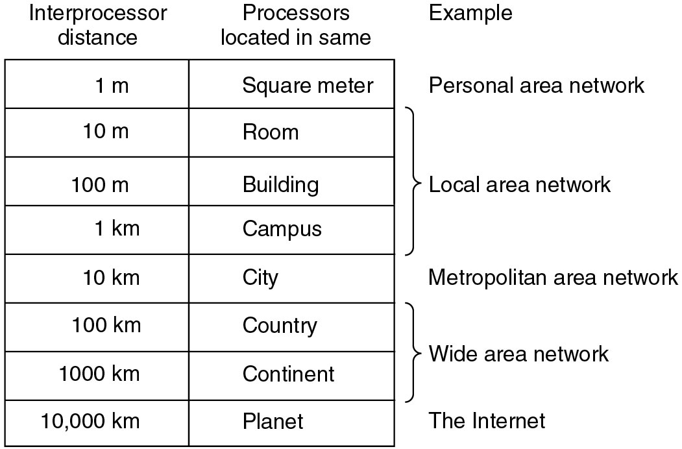
Network Hardware
Based on types of transmission technology
Broadcast Networks
Point-to-point Networks
Based on Scale

Slide 13
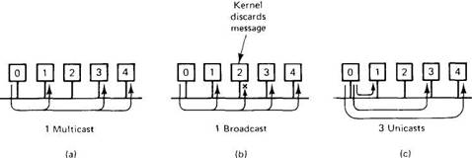
Network Hardware
Broadcast Networks
A single communication channel is shared by all the machines on the network
Short messages called packets sent by any machine are received by all the others
Address field in a packet specifies the recipient
After receiving the packet, the address field is checked
If it is intended for itself, it processes the packet, otherwise it is ignored

Slide 14
Network Hardware
Broadcasting
Broadcast systems allow the possibility of addressing a packet to all destinations by using special code in the address field
Smaller localized network use broadcasting
Multicasting
Broadcast systems also support transmission to a subset of the machines
By reserving a bit to indicate multicasting & the remaining n-1 address bits can hold the group number
Each machine can subscribe to any or one of the groups

Slide 15
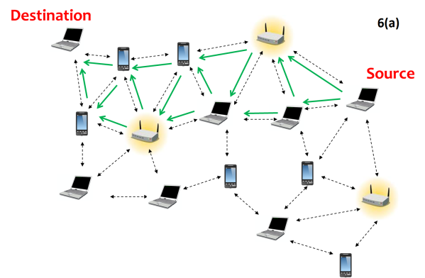
Network Hardware
Point-to-point Networks
Many connections between individual pair of machines
Transfer from source to destination may includes one or more intermediate machines
Multiple routes of different lengths leads to the role of routing algorithm for route selection
Larger networks use point-to-point
Point-to-point transmission with one sender and one receiver is sometimes called unicasting

Slide 16
Network Hardware
Based on Scale
Personal Area Networks
Local Area Networks
Metropolitan Area Networks
Wide Area Networks
Internetworks or Internet

Slide 17
Network Hardware
Personal Area Networks
Networks that are meant for one person
Eg: a wireless network connecting a computer with its mouse, keyboard, and printer
Local Area Networks
Generally called as LANs
Privately owned networks
Inter-processor distance:10m to 1km
Networks placed in a single room or building or campus
LANs are distinguished by 3 characteristics –
Size
Transmission Technology
Topology

Slide 18
LAN
Size :-
Worst-case transmission time is bounded and known in advance.
Knowing this bound makes it possible to use certain kinds of designs
Simplifies Network management.
Transmission Technology :-
consist of a single cable to which all the machines are attached .
Traditional LAN runs at speed of 10 to 100 Mbps
Newer LANs operate at 10 Gbps
Low delay
Makes very few errors

Slide 19
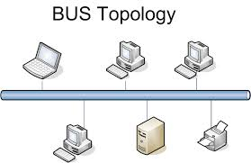
LAN
Topology :-
2 broadcast network types:
Bus & Ring
Bus (Linear cable) network
at any instant, at most one machine is the master and is allowed to transmit.
All other machines are required to refrain from sending
Arbitration mechanism :- to resolve conflicts when two or more machines want to transmit simultaneously.
It may be Centralized or distributed (decentralized)

Slide 20
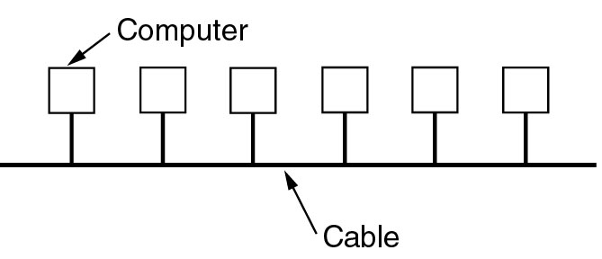
LAN
Eg:-IEEE 802.3 popularly called Ethernet is bus based broadcast network with decentralized control
operates at 10 Mbps to 10 Gbps
Computers on an Ethernet can transmit whenever they want to;
if two or more packets collide, each computer just waits a random time and tries again later

Slide 21
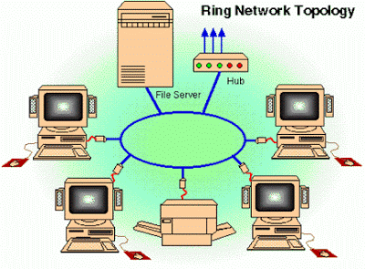
LAN
Ring Network:
Devices acts as repeaters to boost the signal
The transmission of data takes place by token passing.
A token is a special series of bits that contains control information.
Possession of the token allows a network device to transmit data to the network.
Each network has only one token.

Slide 22
LAN
Working of Ring Network:
The sending computer removes the token from the ring and sends the requested data around the ring.
Each computer passes the data until the packet finds the computer that matches the address on the data.
The receiving computer then returns a message to the sending computer indicating that the data has been received.
After verification, the sending computer creates a new token and releases it to the network.

Slide 23
LAN
Ring Network:
Advantages:
Very orderly network where every device has access to the token and the opportunity to transmit
Performs better than a bus topology under heavy network load
Does not require network server to manage the connectivity between the computers
Disadvantages:
One malfunctioning workstation or bad port can create problems for the entire network
Devices moved, added and changed can affect the network
Network adapter cards are much more expensive than Ethernet cards and hubs
Much slower than an Ethernet network under normal load

Slide 24
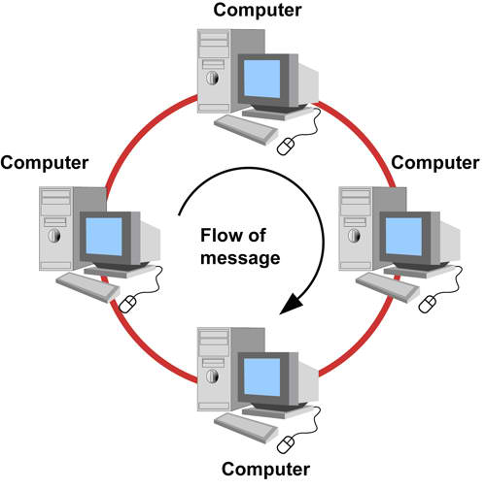
LAN
Ring Network:
Egs:
IEEE 802.5 (the IBM token ring), is a ring-based LAN
operates at 4 and 16 Mbps.
FDDI (Fiber Distributed Data Interface) is another example of a ring network

Slide 25
LAN
Broadcast networks can be further divided into 2, depending on how the channel is allocated
Static and Dynamic
A typical static allocation is
to divide time into discrete intervals and use a round-robin algorithm
allowing each machine to broadcast only when its time slot comes up
Drawback: wastes channel capacity when a machine has nothing to say during its allocated slot
So, most systems attempt to allocate the channel dynamically (i.e., on demand).

Slide 26
LAN
Dynamic allocation methods are either centralized or decentralized.
In the centralized channel allocation method,
there is a single entity,
for example, a bus arbitration unit,
which determines who goes next.
It might do this by accepting requests and making a decision according to some internal algorithm.
In the decentralized channel allocation method,
there is no central entity;
each machine must decide for itself whether to transmit.

Slide 27
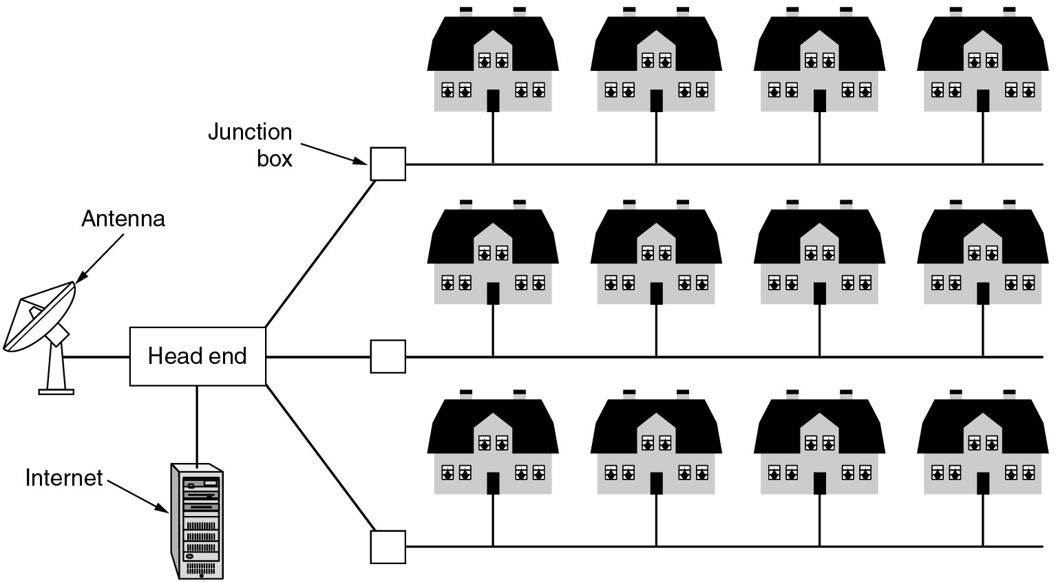
Metropolitan Area Networks (MAN)
A metropolitan area network based on cable TV in a city.
Another eg: IEEE 802.16 (Broadband wireless MANs) for high-speed wireless Internet access

Slide 28
Wide Area Networks (WAN)
WAN spans a large geographical area, often a country or continent
It contains a collection of machines called hosts intended for running user (i.e., application) programs
The hosts are owned by the customers
The hosts are connected by a communication subnet, or just subnet
The communication subnet is typically owned and operated by a telephone company or Internet service provider
The job of the subnet is to carry messages from host to host, just as the telephone system carries words from speaker to listener

Slide 29
Wide Area Networks (WAN)
Subnet consists of two distinct components:
transmission lines
switching elements
Transmission lines
move bits between machines.
made of copper wire, optical fiber, or even radio links.
Switching elements
Specialized computers that connect three or more transmission lines.
When data arrive on an incoming line, it must choose an outgoing line on which to forward them.
Switching elements are also called as routers

Slide 30
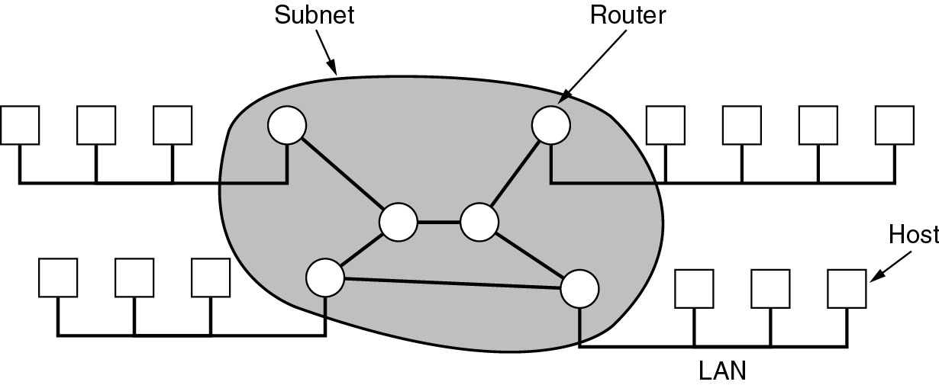
Wide Area Networks (WAN)
Relation between hosts on LANs and the subnet.

Slide 31
Wide Area Networks (WAN)
Store-and-forward or packet-switched subnet
When a packet is sent from one router to another via one or more intermediate routers,
the packet is received at each intermediate router in its entirety,
stored there until the required output line is free, and then forwarded.
When the packets are small and all of the same size, they are often called cells

Slide 32
Wide Area Networks (WAN)
Principle of a packet-switched WAN:
When a process on some host has a message to be sent to a process on some other host,
the sending host first cuts the message into packets,
each one bearing its number in the sequence.
These packets are then injected into the network one at a time in quick succession.
The packets are transported individually over the network and deposited at the receiving host,
where they are reassembled into the original message and delivered to the receiving process

Slide 33
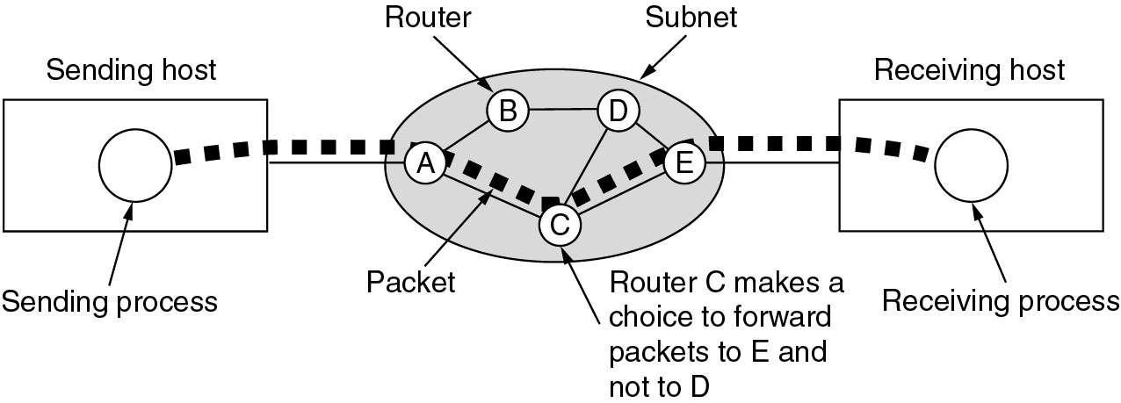
Wide Area Networks
A stream of packets from sender to receiver.
Routing decisions are made locally.
When a packet arrives at router A, it is up to A to decide if this packet should be sent on the line to B or the line to C.
How A makes that decision is called the routing algorithm.

Slide 34
Wide Area Networks (WAN)
Not all WANs are packet switched.
A second possibility for a WAN is a satellite system.
Each router has an antenna through which it can send and receive.
All routers can hear the output from the satellite
In some cases, they can also hear the upward transmissions of their fellow routers to the satellite as well.
Sometimes the routers are connected to a substantial point-to-point subnet, with only some of them having a satellite antenna.
Satellite networks are inherently broadcast and are most useful when the broadcast property is important

Slide 35
Internetworks
A collection of interconnected networks is called an internetwork or internet
A common form of internet is a collection of LANs connected by a WAN
If the intermediate system contains only routers, it is a subnet
if it contains both routers and hosts, it is a WAN
An internetwork is formed when distinct networks are interconnected

Slide 36
Wireless Networks
Digital wireless communication is not a new idea.
As early as 1901, the Italian physicist Marconi demonstrated a ship-to-shore wireless telegraph, using Morse Code (dots and dashes as binary).
Modern digital wireless systems have better performance, but the basic idea is the same.
Categories of wireless networks:
System interconnection
Wireless LANs
Wireless WANs

Slide 37
Wireless Networks
System interconnection
interconnecting the components of a computer using short-range radio
every computer has a monitor, keyboard, mouse, and printer connected to the main unit by cables
some companies got together to design a short-range wireless network called Bluetooth to connect these components without wires
Bluetooth also allows digital cameras, headsets, scanners, and other devices to connect to a computer by merely being brought within range

Slide 38
Wireless Networks
System interconnection
System interconnection networks use the master-slave paradigm
System unit is normally the master, talking to the mouse, keyboard, etc., as slaves.
The master tells the slaves
what addresses to use,
when they can broadcast,
how long they can transmit,
what frequencies they can use, and so on

Slide 39
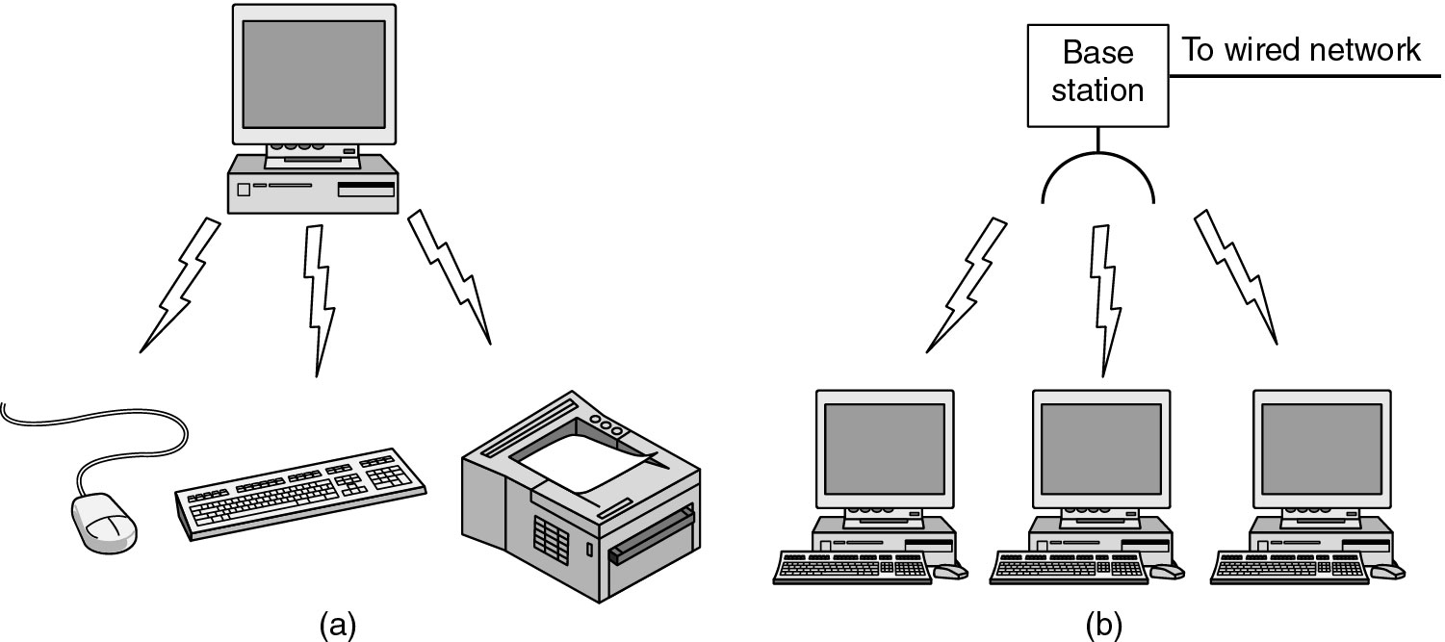
Wireless Networks
(a) Bluetooth configuration
(b) Wireless LAN

Slide 40
Wireless Networks
Wireless LANs
systems in which every computer has a radio modem and antenna with which it can communicate with other systems
if the systems are close enough, they can communicate directly with one another in a peer-to-peer configuration
Wireless LANs are becoming increasingly common in small offices and homes, where installing Ethernet is considered too much trouble
Standard for wireless LANs is called IEEE 802.11

Slide 41
Wireless Networks
Wireless WANs
radio network used for cellular telephones is an example of a low-bandwidth wireless system.
This system has already gone through three generations.
The first generation was analog and for voice only.
The second generation was digital and for voice only.
The third generation is digital and is for both voice and data.

Slide 42
Wireless Networks
Wireless WANs
In a certain sense, cellular wireless networks are like wireless LANs, except that the distances involved are much greater and the bit rates much lower.
Wireless LANs can operate at rates up to about 50 Mbps over distances of tens of meters.
Cellular systems operate below 1 Mbps, but the distance between the base station and the computer or telephone is measured in kilometers

Slide 43
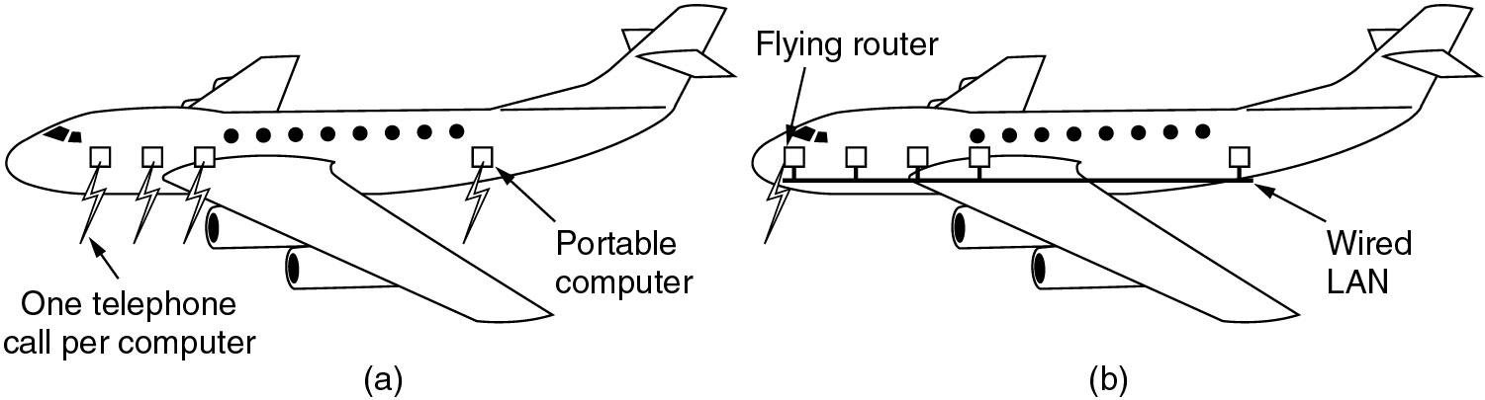
Wireless Networks
Individual independent mobile computers
airplane with a number of people using modems and seat-back telephones to call the office independently.
(b) A flying LAN (more efficient)
each seat comes equipped with an Ethernet connector into which passengers can plug their computers.
A single router on the aircraft maintains a radio link with some router on the ground, changing routers as it flies along.
This is just a traditional LAN, except that its connection to the outside world is a radio link instead of a hardwired line

Slide 44
Home Network Categories
Computers (desktop PC, PDA, shared peripherals)
Entertainment (TV, DVD, VCR, camera, stereo, MP3)
Telecomm (telephone, cell phone, intercom, fax)
Appliances (microwave, fridge, lights)
Telemetry (utility meter, burglar alarm, thermostat, babycam).

Slide 45
Network Software
Protocol Hierarchies
Design Issues for the Layers
Connection-Oriented and Connectionless Services
Service Primitives
The Relationship of Services to Protocols

Slide 46
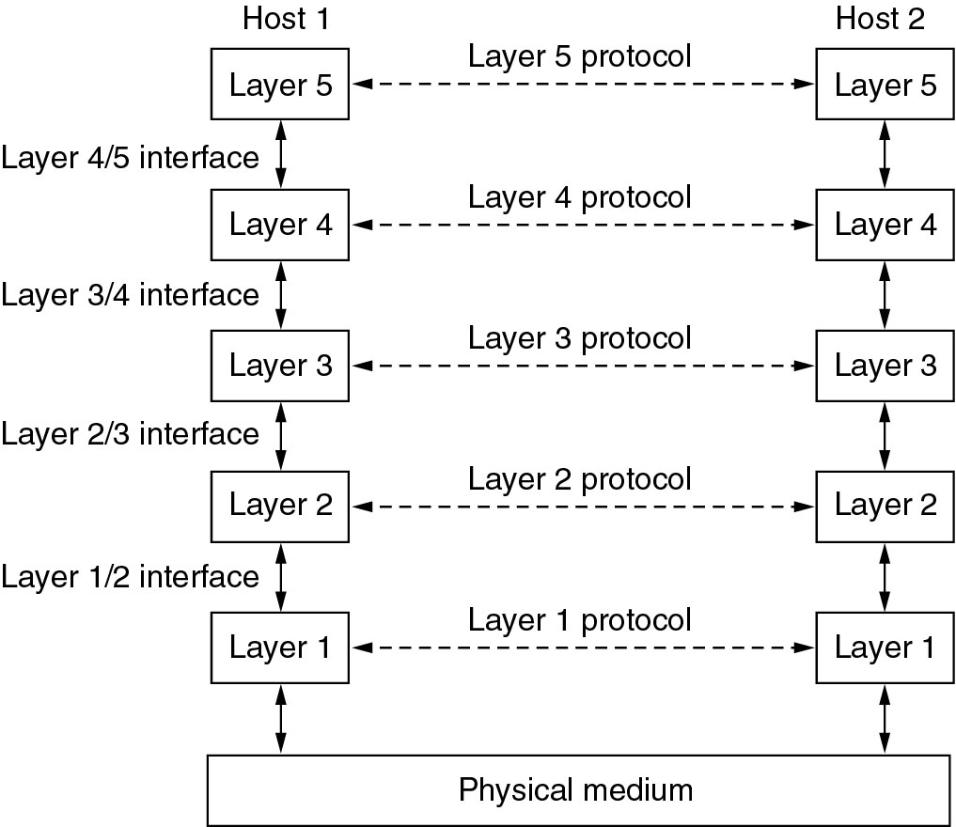
Network Software Protocol Hierarchies

Slide 47
Protocol Hierarchies
To reduce their design complexity, most networks are organized as a stack of layers or levels
Number of layers, name of each layer, contents of each layer, and function of each layer differ from network to network
Purpose of each layer
to offer certain services to the higher layers,
shielding those layers from the details of how the offered services are actually implemented
The rules and conventions used in this conversation are collectively known as the layer n protocol
Protocol is an agreement between the communicating parties on how communication is to proceed

Slide 48
Protocol Hierarchies
No data are directly transferred from layer n on one machine to layer n on another machine.
Instead, each layer passes data and control information to the layer immediately below it, until the lowest layer is reached.
Below layer 1 is the physical medium through which actual communication occurs
Between each pair of adjacent layers is an interface
Interface defines which primitive operations and services the lower layer makes available to the upper one

Slide 49
Protocol Hierarchies
clear-cut interfaces makes it simpler to replace the implementation of one layer with a completely different implementation
e.g., all the telephone lines are replaced by satellite channels
A set of layers and protocols is called a network architecture
A list of protocols used by a certain system, one protocol per layer, is called a protocol stack

Slide 50
Protocol Hierarchies

Slide 51
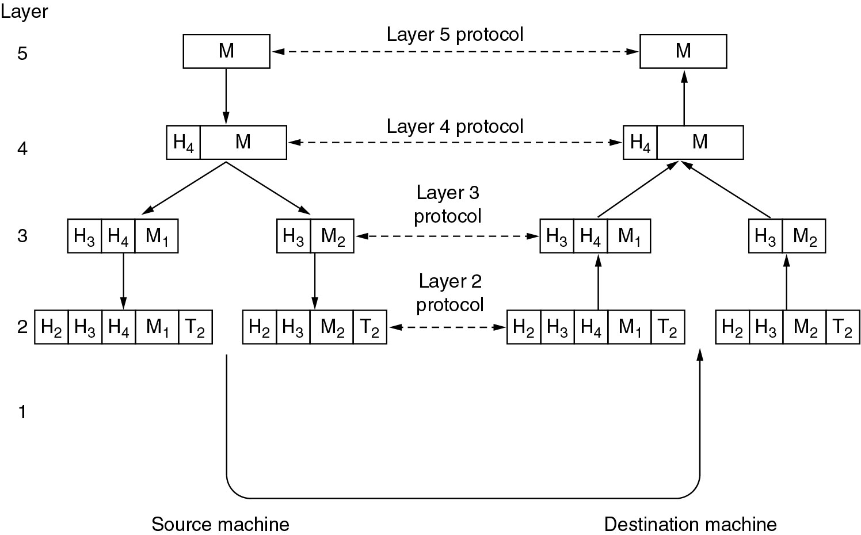
Protocol Hierarchies
header & trailer includes control information, such as sequence numbers, sizes, times, and other control fields

Slide 52
Design Issues for the Layers
Addressing
Rules for data transfer
Error Control
Flow Control
Long messages
Too short messages
Multiplexing & demultiplexing
Routing

Slide 53
Design Issues for the Layers
Addressing
Every layer needs a mechanism for identifying senders and receivers
So, addressing is required
Rules for data transfer
Unidirectional or bidirectional (Simplex / Half duplex / Full duplex)
Protocol must determine how many logical channels the connection corresponds to and what their priorities are
Many networks provide at least two logical channels per connection, one for normal data and one for urgent data.

Slide 54
Design Issues for the Layers
Error Control
Problem: physical communication circuits are not perfect
error-detecting and error-correcting codes are available
both ends of the connection must agree on which one is being used
receiver must have some way of telling the sender which messages have been correctly received and which have not
To deal with a possible loss of sequencing, the protocol must make explicit provision for the receiver to allow the pieces to be reassembled properly

Slide 55
Design Issues for the Layers
Flow Control
Problem: how to keep a fast sender from swamping (overloading) a slow receiver with data
Solution 1: some kind of feedback from the receiver to the sender, about the receiver's current situation
Solution 2: limit the sender to an agreed-on transmission rate (flow control)
Long messages
Problem: inability of all processes to accept arbitrarily long messages
Solution: disassembling, transmitting, and then reassembling messages

Slide 56
Design Issues for the Layers
Too short messages
Problem: transmitting data in units that are so small that sending each one separately is inefficient.
Solution: to gather several small messages heading toward a common destination into a single large message and dismember the large message at the other side.
Multiplexing & demultiplexing
underlying layer may decide to use the same connection for multiple, unrelated conversations (Physical layer)
Routing
When there are multiple paths between source and destination, a route must be chosen based on the current traffic load

Slide 57
Connection-Oriented Services
Similar to telephone service
to use a connection-oriented network service, the service user
establishes a connection,
uses the connection, and
releases the connection
acts like a tube
sender pushes objects (bits) in at one end, and the receiver takes them out at the other end
the order is preserved so that the bits arrive in the order they were sent

Slide 58
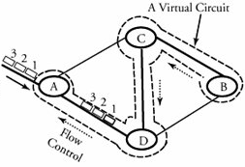
Connection-Oriented Services
When a connection is established, the sender, receiver, and subnet conduct a negotiation
about parameters to be used, such as
maximum message size,
quality of service
error rates,
bandwidth,
throughput,
transmission delay,
jitter,
Availability
other issues.
Typically, one side makes a proposal and the other side can accept it, reject it, or make a counterproposal

Slide 59
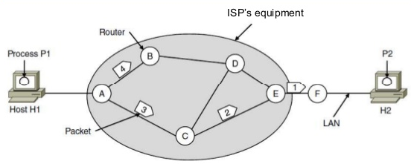
Connectionless Services
Similar to postal system
Each message (letter) carries the full destination address
Each one is routed through the system independent of all the others

Slide 60
Connection-Oriented Services
Classifications: Reliable & Unreliable
Each service can be characterized by a quality of service
Some services are reliable that they never lose data.
A reliable service is implemented by having the receiver acknowledge the receipt of each message so the sender is sure that it arrived.
The acknowledgement process introduces overhead and delays, which are often worth it but are sometimes undesirable
Eg for reliable connection-oriented service is file transfer
Reliable connection-oriented service has two minor variations:
message sequences and
byte streams

Slide 61
Connection-Oriented Services
Message sequences
message boundaries are preserved.
When two 1024-byte messages are sent, they arrive as two distinct 1024-byte messages, never as one 2048-byte message
Eg: Sending the pages of book
Byte streams
connection is simply a stream of bytes, with no message boundaries.
When 2048 bytes arrive at the receiver, there is no way to tell if they were sent as one 2048-byte message, two 1024-byte messages, or 2048 1-byte messages
Eg: user logging details to a remote server

Slide 62
Connection-Oriented Services
For some applications, transit delays introduced by acknowledgements are unacceptable. (Unreliable is better)
Application 1: digitized voice traffic.
It is preferable for telephone users to hear a bit of noise on the line from time to time than to experience a delay waiting for acknowledgements.
Application 2: video conference
when transmitting a video conference, having a few pixels wrong is no problem, but having the image jerk along as the flow stops to correct errors is irritating

Slide 63
Connectionless Services
Connectionless service is often called datagram service
Unreliable (meaning not acknowledged) datagram service
does not return an acknowledgement to the sender
Eg: junk mails
acknowledged datagram service
convenience of not having to establish a connection to send one short message is desired,
but reliability is essential.
Eg: sending a registered letter and requesting a return receipt
request-reply service
the sender transmits a single datagram containing a request; the reply contains the answer
Egs: a query to the local library, Client server model

Slide 64
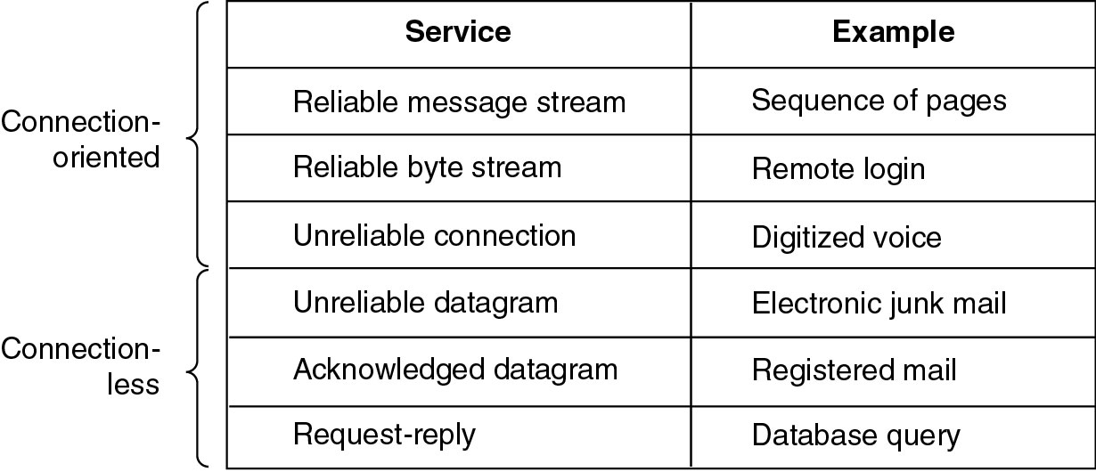
Connection-Oriented and Connectionless Services
Six different types of service.

Slide 65
Interfaces & Services
active elements in each layer are called entities
An entity can be a
software entity (such as a process), or
hardware entity (such as an intelligent I/O chip)
Entities in the same layer on different machines are called peer entities
entities in layer n implement a service used by layer n+ 1
Layer n is the service provider
Layer n + 1 is the service user
Classes of services
Fast & expensive communication
Slow & cheap communication

Slide 66
Interfaces & Services
Services are available at SAPs (Service Access Points)
IDU
Layer n+1
ICI
IDU – Interface Data Unit
ICI – Interface Control Information
SDU – Service Data Unit
SAP – Service Access Point
SDU
SAP
Interface
Layer n
ICI
SDU
Each SAP has an address that uniquely identifies it
Eg: SAPs are the sockets into which telephones are plugged
SAP addresses are telephone numbers of sockets

Slide 67
Service Primitives
A service is specified by a set of primitives (operations) available to a user process to access the service.
These primitives tell the service to perform some action or report on an action taken by a peer entity.
If the protocol stack is located in the operating system, the primitives are normally system calls.
These calls cause a trap to kernel mode, which then turns control of the machine over to the operating system to send the necessary packets.

Slide 68
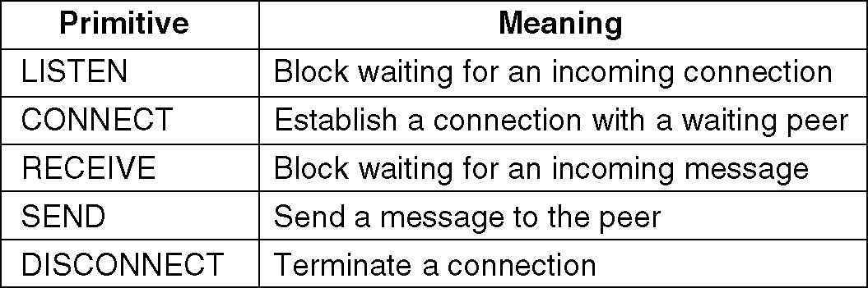
Service Primitives
Five service primitives for implementing a simple connection-oriented service.

Slide 69
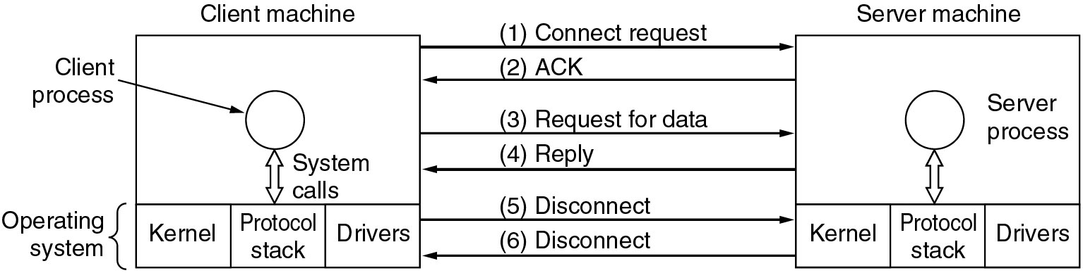
Service Primitives
Packets sent in a simple client-server interaction on a connection-oriented network.

Slide 70
Service Primitives
Eg Illustration:
Server executes LISTEN to indicate that it is prepared to accept incoming connections.
A common way to implement LISTEN is to make it a blocking system call.
After executing the primitive, the server process is blocked until a request for connection appears
Client process executes CONNECT to establish a connection with the server
Operating system then typically sends a packet to the peer asking it to connect
Client process is suspended until there is a response

Slide 71
Service Primitives
When the packet arrives at the server, it is processed by its operating system
When the system sees that the packet is requesting a connection, it checks to see if there is a listener.
If so, it does two things:
unblocks the listener and
sends back an acknowledgement
arrival of this acknowledgement then releases the Client
At this point the Client and Server are both running and they have a connection established
If a connection request arrives and there is no listener, the result is undefined

Slide 72
Service Primitives
The next step is for the Server to execute RECEIVE to prepare to accept the first request.
Normally, the server does this immediately upon being released from the LISTEN, before the acknowledgement can get back to the client.
The RECEIVE call blocks the Server
Then the Client executes SEND to transmit its request followed by the execution of RECEIVE to get the reply
The arrival of the request packet at the server machine unblocks the Server process so it can process the request.
After it has done the work, it uses SEND to return the answer to the Client.
The arrival of this packet unblocks the Client, which can now inspect the answer.

Slide 73
Service Primitives
If the Client has additional requests, it can make them now.
If it is done, it can use DISCONNECT to terminate the connection.
Usually, an initial DISCONNECT is a blocking call, suspending the client and sending a packet to the server saying that the connection is no longer needed.
When the Server gets the packet, it also issues a DISCONNECT of its own, acknowledging the client and releasing the connection.
When the Server's packet gets back to the Client machine, the Client process is released and the connection is broken.

Slide 74
Reference Models
The OSI Reference Model
The TCP/IP Reference Model

Slide 75
OSI Reference Model
The model is called the ISO OSI (International Organization for Standardization Open Systems Interconnection) Reference Model.
because it deals with connecting open systems
ie, systems that are open for communication with other systems
OSI model has seven layers
Physical layer
Data link layer
Network Layer
Transport Layer
Session Layer
Presentation Layer
Application Layer

Slide 76
OSI Reference Model
Principles behind the seven layer design
A layer should be created where a different abstraction (concept) is needed.
Each layer should perform a well-defined function.
The function of each layer should be based on internationally Standardized Protocols
The layer boundaries should be chosen to minimize the information flow across the interfaces
number of layers should be
large enough that distinct functions need not be thrown together in the same layer out of necessity
small enough that the architecture does not become unmanageable

Slide 77
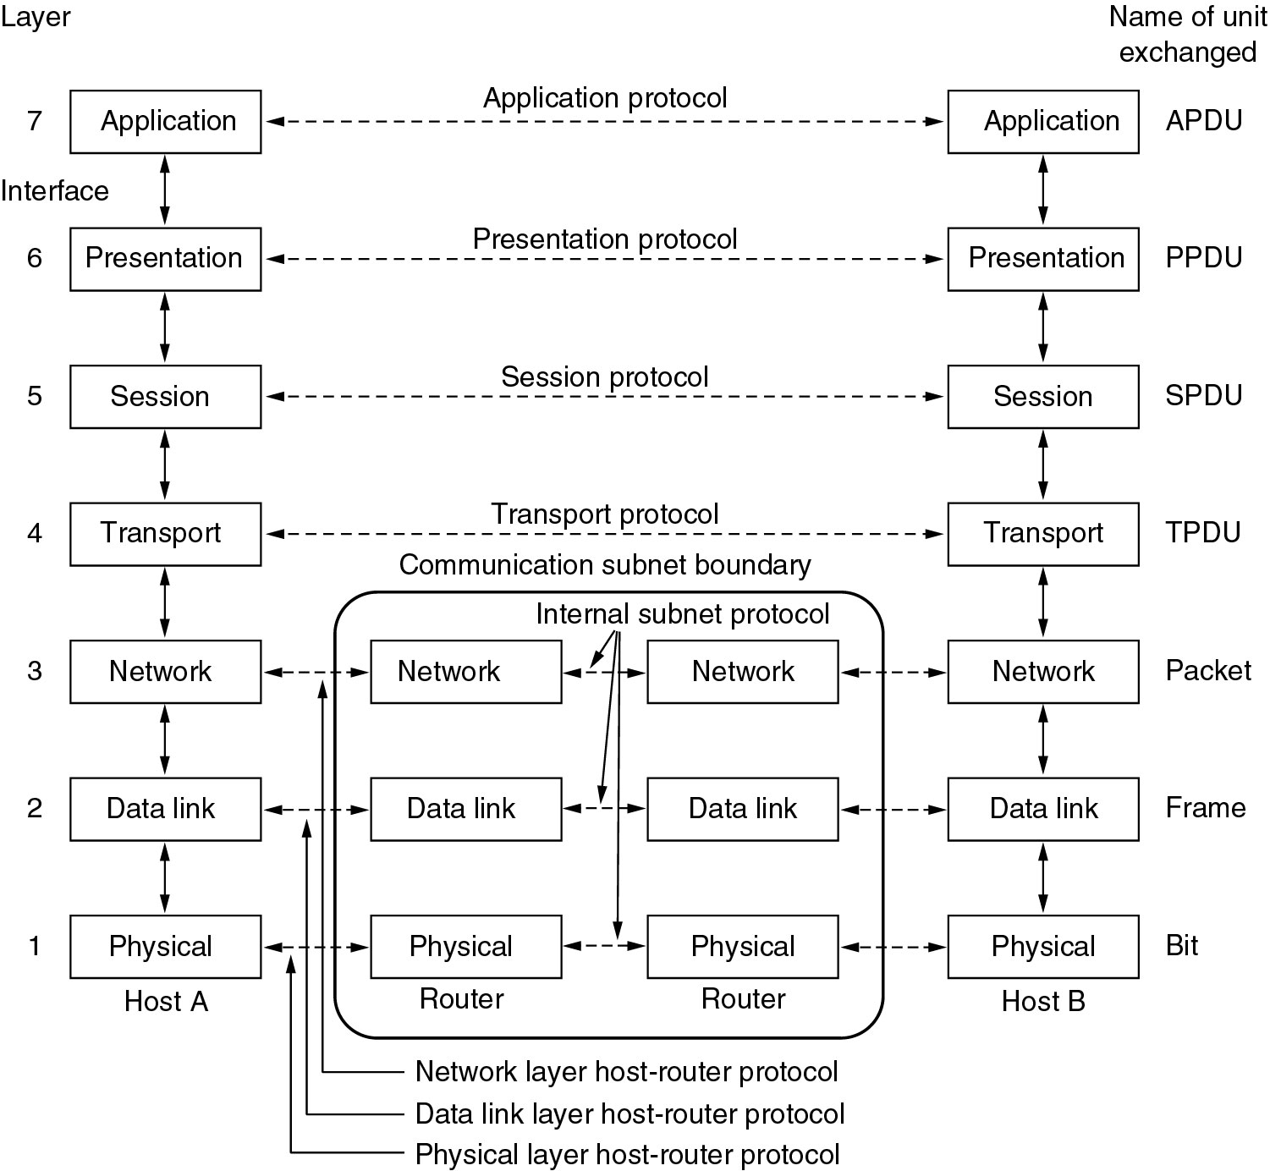
OSI Reference Models

Slide 78
OSI Reference Model
Physical Layer
concerned with transmitting raw bits over a communication channel
Design issues are
when one side sends a 1 bit, it is received by the other side as a 1 bit, not as a 0 bit.
how many volts should be used to represent a 1 and how many for a 0,
how many nanoseconds a bit lasts,
whether transmission may proceed simultaneously in both directions,
how the initial connection is established and
how it is torn down when both sides are finished,
how many pins the network connector has
what each pin is used for

Slide 79
OSI Reference Model
Physical Layer
Design issues deal with
Mechanical, electrical, & timing interfaces, and
physical transmission medium, which lies below the physical layer
Data link Layer
Main task: Error Control
to transform a raw transmission facility into a line that appears free of undetected transmission errors to the network layer
sender break up the input data into data frames (typically a few hundred or a few thousand bytes) and transmit the frames sequentially
If the service is reliable, the receiver confirms correct receipt of each frame by sending back an acknowledgement frame

Slide 80
OSI Reference Model
Data link Layer
Another Issue: Flow control
how to keep a fast transmitter from drowning a slow receiver in data
traffic regulation mechanism is often needed to let the transmitter know how much buffer space the receiver has
Additional issue in broadcast networks:
how to control access to the shared channel
Data link layer is subdivided into 2 for this purpose
Logical Link Control (LLC) sub layer
Medium Access Control (MAC) sub layer
MAC handles the broadcast networks

Slide 81
OSI Reference Model
Network Layer
controls the operation of the subnet
design issues
determining how packets are routed from source to destination
Routes
can be based on static tables that are fixed into the network and are rarely changed
can be highly dynamic, being determined anew for each packet, to reflect the current network load
can also be determined at the start of each conversation (e.g., a login to a remote machine)

Slide 82
OSI Reference Model
Network Layer
Congestion control
If too many packets are present in the subnet at the same time, they will get in one another's way creating congestion
Providing QOS
transit time, delay, jitter, error rate, bandwidth, availability, throughput, etc
to allow heterogeneous networks (different addressing, protocols, message size, etc) to be interconnected
In broadcast networks, the routing problem is simple
so the network layer is often thin or even nonexistent

Slide 83
OSI Reference Model
Transport Layer
Basic function
to accept data from above,
split it up into smaller units if needed,
pass these to the network layer, and
ensure that all the pieces arrive correctly at the other end.
All this must be done efficiently in a way that isolates the upper layers from the inevitable changes in the hardware technology
determines what type of service to provide to the session layer, and, ultimately, to the users of the network

Slide 84
OSI Reference Model
Transport Layer
most popular type of transport connection
error-free point-to-point channel that delivers messages or bytes in the order in which they were sent
other possible kinds of transport service
transporting of isolated messages, with no guarantee about the order of delivery, and
the broadcasting of messages to multiple destinations
Type of service is determined when the connection is established

Slide 85
OSI Reference Model
Transport Layer
transport layer is a true end-to-end layer, all the way from the source to the destination
ie, a program on the source machine carries on a conversation with a similar program on the destination machine, using the message headers and control messages.
In the lower layers, the protocols are between each machine and its immediate neighbors (routers), and not between the ultimate source and destination machines

Slide 86
OSI Reference Model
Session Layer
allows users on different machines to establish sessions between them
Sessions offer various services, including
Dialog control
keeping track of whose turn it is to transmit
Token management
preventing two parties from attempting the same critical operation at the same time
Synchronization
check pointing long transmissions to allow them to continue from where they were after a crash

Slide 87
OSI Reference Model
Presentation Layer
concerned with the syntax and semantics of the information transmitted
In order to make it possible for computers with different data representations to communicate
the data structures to be exchanged can be defined in an abstract way
along with a standard encoding to be used on the wire
manages these abstract data structures and allows higher-level data structures (e.g., banking records) to be defined and exchanged

Slide 88
OSI Reference Model
Application Layer
Contains a variety of protocols that are commonly needed by users
Widely-used application protocol
HTTP (Hyper Text Transfer Protocol)
basis for the World Wide Web
When a browser wants a Web page, it sends the name of the page it wants to server using HTTP
server then sends the page back
Other application protocols
File transfer (FTP)
Electronic mail (SMTP)
Domain Name System (DNS)
Network News Transfer Protocol (NNTP)

Slide 89
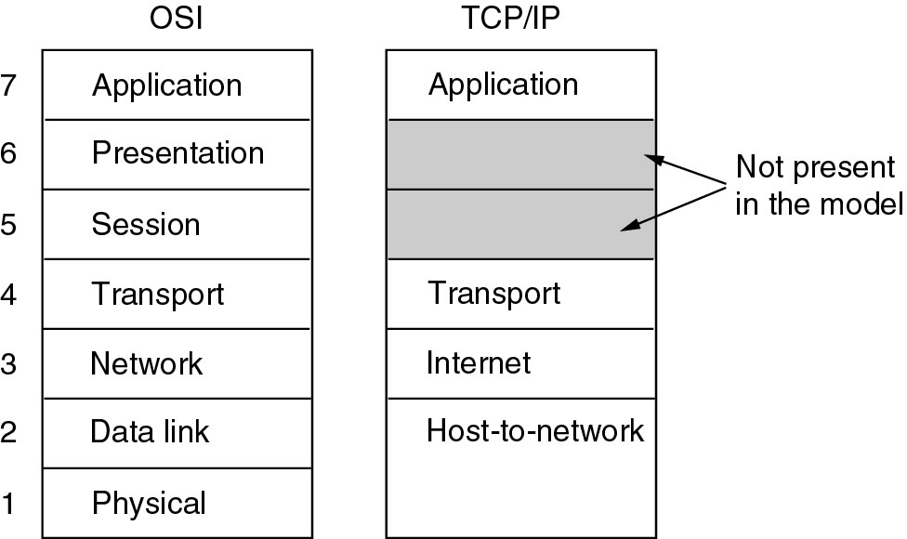
TCP/IP Reference Models

Slide 90
TCP/IP Reference Model
Reference model used in the ARPANET (grandparent of all WAN) and its successor, the worldwide Internet
ARPANET (Advanced Research Projects Agency Network)
Research network sponsored by the DoD (U.S. Department of Defense)
Connected hundreds of Universities and Government installations, using leased telephone lines
When satellite and radio networks were added later, the existing protocols had trouble interworking with them
So, a new reference architecture was needed
Thus, the ability to connect multiple networks in a seamless way was one of the major design goals from the very beginning
This architecture later became known as the TCP/IP Reference Model, after its two primary protocols

Slide 91
TCP/IP Reference Model
Another major goal
network must be able to survive loss of subnet hardware, with existing conversations not being broken off.
ie, DoD wanted connections to remain intact as long as the source and destination machines were functioning
even if some of the machines or transmission lines in between were suddenly put out of operation.
Also, a flexible architecture was needed
since applications with divergent requirements were envisioned, ranging from transferring files to real-time speech transmission

Slide 92
TCP/IP Reference Model
Host-to-Network Layer
host has to connect to the network using some protocol so that it can send IP packets to it
protocol is not defined and varies from host to host and network to network
TCP/IP reference model does not really say much about what happens here
Internet Layer
All requirements of DoD led to the choice of a packet-switching network based on a connectionless internetwork layer
This layer is called the internet layer, because it is the key player that holds the whole architecture together

Slide 93
TCP/IP Reference Model
Internet Layer
Job is to permit hosts to inject packets into any network and
have them travel independently to the destination on a different network
They may even arrive in a different order than they were sent
it is the job of higher layers to rearrange them, if in-order delivery is desired
Note that ''internet'' is used here in a generic sense, even though this layer is present in the Internet

Slide 94
TCP/IP Reference Model
Internet Layer
Internet layer defines an official packet format and protocol called IP (Internet Protocol).
The job of the internet layer is to deliver IP packets where they are supposed to go.
Packet routing & avoiding congestion are the major issue here
For these reasons, it is reasonable to say that the TCP/IP internet layer is similar in functionality to the OSI network layer

Slide 95
TCP/IP Reference Model
Transport Layer
designed to allow peer entities on the source and destination hosts to carry on a conversation
Two end-to-end transport protocols
TCP (Transmission Control Protocol)
UDP (User Datagram Protocol)
TCP
Reliable connection-oriented protocol
allows a byte stream originating on one machine to be delivered without error on any other machine in the internet.
It fragments the incoming byte stream into discrete messages and passes each one on to the internet layer.

Slide 96
TCP/IP Reference Model
Transport Layer
TCP
At the destination, the receiving TCP process reassembles the received messages into the output stream
TCP also handles flow control to make sure a fast sender cannot swamp a slow receiver with more messages than it can handle

Slide 97
TCP/IP Reference Model
Transport Layer
UDP
Unreliable connectionless protocol
for applications that do not want TCP's sequencing or flow control and wish to provide their own
also widely used for one-shot, client-server-type request-reply queries and
applications in which prompt delivery is more important than accurate delivery, such as transmitting speech or video

Slide 98
TCP/IP Reference Model
Application Layer
TCP/IP model does not have session or presentation layers
Because they are of little use to most applications
contains all the higher-level protocols like
virtual terminal (TELNET)
file transfer (FTP)
electronic mail (SMTP)
Domain Name System (DNS)
Network News Transfer Protocol (NNTP)
Hyper Text Transfer Protocol (HTTP)

Slide 99
TCP/IP Reference Model
Application Layer
TELNET
virtual terminal protocol allows a user on one machine to log onto a distant machine and work there
FTP (File Transfer Protocol )
provides a way to move data efficiently from one machine to another
SMTP (Simple Mail Transfer Protocol)
Electronic mail was originally just a kind of file transfer, but later a specialized protocol (SMTP) was developed for it

Slide 100
TCP/IP Reference Model
Application Layer
DNS (Domain Name System)
for mapping host names onto their network addresses
NNTP (Network News Transfer Protocol )
protocol for moving USENET news articles around
USENET (worldwide distributed Internet discussion system)
HTTP (Hyper Text Transfer Protocol )
protocol for fetching pages on the World Wide Web (WWW)

Slide 101
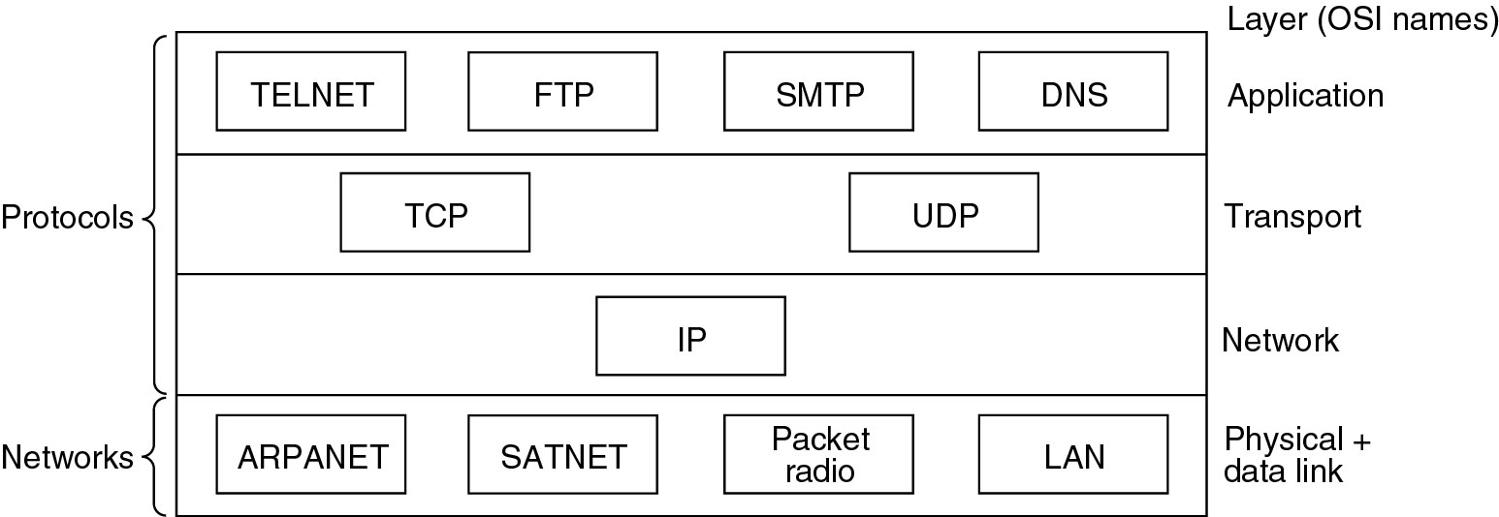
Reference Models
Protocols and networks in the TCP/IP model initially.
ARPANET - Advanced Research Projects Agency Network
SATNET – Sustainable Agriculture Trainers Network

Slide 102
Assignment I
Comparison & critiques of OSI and TCP/IP Models

